Slide 1









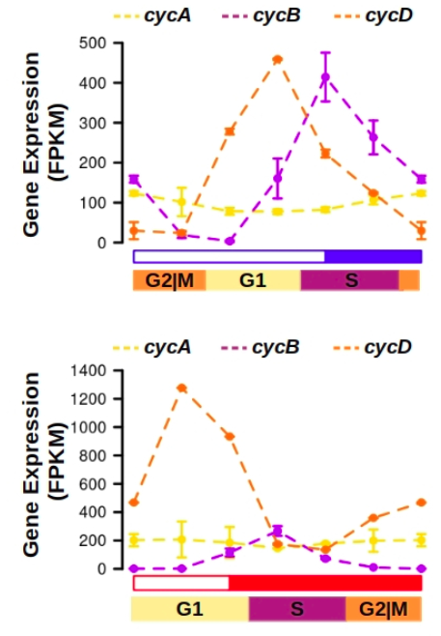





(A)
G1 Phase
(B)
S Phase
(C)
G2 Phase
Cells
Cells
Cells
Proteins
Proteins
Proteins
Genes
Genes
Genes
G2|M
G1
S
G2|M
G1
S
G2|M
G1
S
ZT0
ZT4
ZT8
ZT12
ZT16
ZT20
ZT0
ZT0
ZT4
ZT8
ZT12
ZT16
ZT20
ZT0
ZT0
ZT4
ZT8
ZT12
ZT16
ZT20
ZT0
Cells
Cells
Cells
Proteins
Proteins
Proteins
Genes
Genes
Genes
G1
S
G2|M
G1
S
G2|M
G1
S
G2|M
ZT0
ZT4
ZT8
ZT12
ZT16
ZT20
ZT0
ZT0
ZT4
ZT8
ZT12
ZT16
ZT20
ZT0
ZT0
ZT4
ZT8
ZT12
ZT16
ZT20
ZT0
(A)
(B)
(C)
cycA
cycB
cycD
cdkA
CDKA
cdkB
CDKB
Gene Expression (FPKM)
Scaled Gene Expression
Protein Abundance
Scaled Gene Expression
Protein Abundance
G2|M
G1
S
G2|M
G1
S
G2|M
G1
S
cycA
cycB
cycD
cdkA
CDKA
cdkB
CDKB
Gene Expression (FPKM)
Scaled Gene Expression
Protein Abundance
Scaled Gene Expression
Protein Abundance
G1
S
G2|M
G1
S
G2|M
G1
S
G2|M
(D)
ftsz
FTSZ
ftsz
FTSZ
Scaled Gene Expression
Protein Abundance
Scaled Gene Expression
Protein Abundance
G2|M
G1
S
G1
S
G2|M

